Slide 1
Temperature / Mask Detection Raspberry Pi
By:-
Max Gogats
Mehul Vani

Slide 2
Introduction
Covid-19 impacting lives greatly
Reopening / staying open has been difficult
Device to help with some of these problems

Slide 3
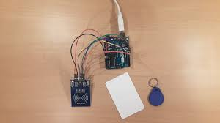
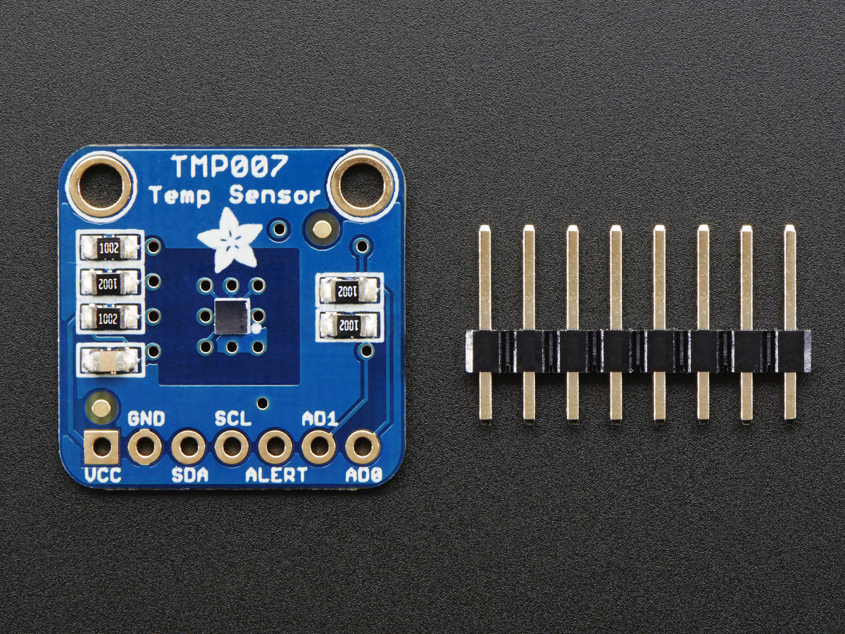
Hardware
Raspberry Pi 3
RC522 Sensor
Thermophile Sensor

Slide 4
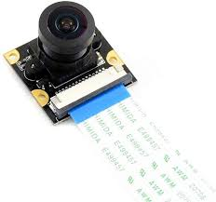
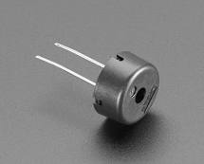
Hardware
Raspberry Pi Camera Module V2-8
Buzzer

Slide 5
Progress
Mask detection on laptop camera
Loaded classifier onto raspberry pi

Slide 6
Data Flow Diagram
RFID barcode data
Database
Temperature Data
Mask Data
Database
Buzzer

Slide 7
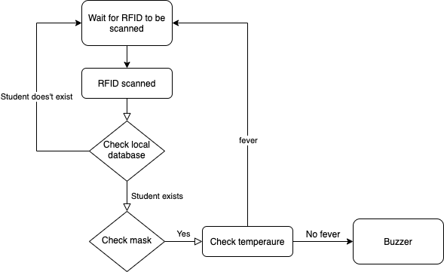
Control Flow Diagram

Slide 8
Environment / Code
Vscode, also can be done on Google Colab or Jupyter lab.
Libraries Os, tensor ,shutil, random, cv2 , numpy, sklearn
Code:
Code 1 : Model
Code 2 : Webcam / Face Detection

Slide 9
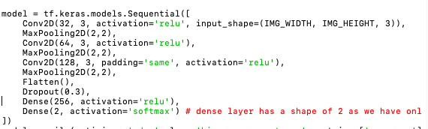
Code
Code 1 : CNN layers

Slide 10
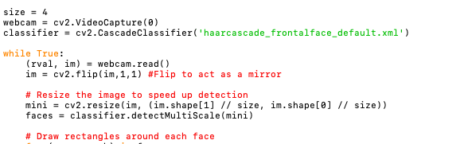
Code
Code 2 : This to turn on the Web camera and detecting face mask

Slide 11
Thank You!

